Slide 1
BIOLOGICAL CLASSIFICATION

Slide 2
Five Kingdom Systems (Whittaker's Concept)
R.H. Whittaker (1969) proposed a Five Kingdom Classification.
The kingdoms were named : Monera, Protista, Fungi, Plantae and Animalia.
Main criteria for classification include
    Cell structure : prokaryotic or eukaryotic
    Body organization: Unicellular or Multicellular
    Mode of nutrition : Autotrophic or Heterotrophic
    Reproduction and
    Phylogenetic relationships

Slide 3
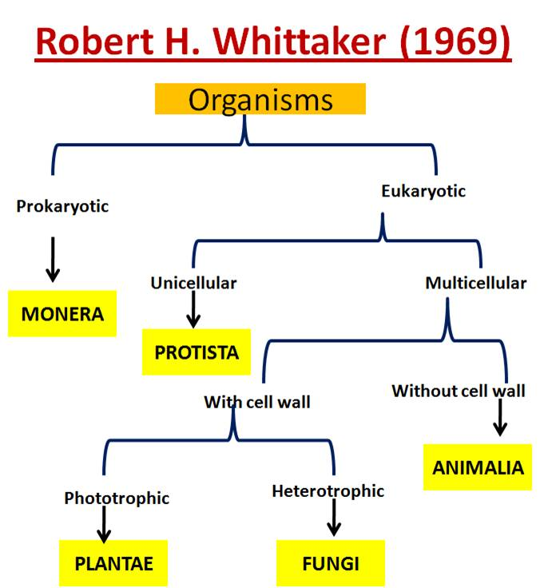

Slide 5
Kingdom Monera
Bacteria :
  Have bacteria a sole member.
  Bacteria can have shapes like: Coccus (spherical), Bacillus (rod-shaped), Vibrio comma shaped) and sprillum (spiral shaped).
  Bacteria found almost everywhere and can be Photosynthetic autotrophs, Chemosynthetic autotrophs or Heterotrophs.

Slide 6
Archaebacteria :
  Differs from bacteria having different cell wall structure.
  They live in most harsh habitats
  Halophiles (salt-loving)
  Thermophiles (in hot springs)
  Acidophiles (high acidic condition)
  Methanogen (marshy area)
  Methanogen are also found in the gut of ruminant and produces biogas.
Eubacteria :
  Called true bacteria having a rigid cell wall, and if motile a flagellum.
  They also known as blue green algae or Cyanobacteria.
  Cyanobacteria are photosynthetic autotrophs.
  Unicellular, colonial or filamentous, marine and terrestrial algae.
  Colonies are surrounded by gelatinous sheath.
  Some of these can fix atmospheric nitrogen by specialized cells called heterocyst, e.g. Nostoc and Anabaena.

Slide 7
  Chemosynthetic autotrophs: Oxidize various inorganic substances like nitrates/nitrites, ammonia and use released energy for their ATP production.
  Heterotrophic bacteria:
    Mostly decomposer
    Helpful in making curd from milk
    Produce antibiotics
    Symbiotically associated with leguminous plant and fix nitrogen.
    Some are pathogen causing diseases like cholera, typhoid, and tetanus.
  Bacteria reproduce mainly by fission, also produce spore in unfavorable condition.
  Reproduce sexually by transfer of DNA form one bacteria to other, the process called conjugation.
Mycoplasma :
  Completely lack cell wall.
  Smallest living cells.
  Can survive without oxygen.
  Pathogenic in animals and plants.

Slide 8
PROTISTA
All unicellular eukaryotes are placed under Protista, but the boundaries of this kingdom are not well defined.
In this book included Chrysophytes, Dinoflagellates, Euglenoids, Slime moulds and Protozoans under Protista.
Members of Protista are primarily aquatic.
Being eukaryotes, the protistan cell body contains a well defined nucleus and other membrane-bound organelles.
Some have flagella or cilia with 11 stranded with 9+2 arrangement
Protists reproduce asexually and sexually by a process involving cell fusion and zygote formation.

Slide 9
Chrysophytes
This group includes diatoms and golden algae (desmids).
They are found in fresh water as well as in marine environments.
They are microscopic and float passively in water currents (plankton).
Most of them are photosynthetic.
In diatoms the cell walls are embedded with silica and thus the walls are indestructible.
Thus, diatoms have left behind large amount of cell wall deposits in their habitat; this accumulation over billions of years is referred to as ‘diatomaceous earth’.
Being gritty this soil is used in polishing, filtration of oils and syrups.
Diatoms are the chief ‘producers’ in the oceans.

Slide 10
Dinoflagellates
These organisms are mostly marine and photosynthetic.
They appear yellow, green, brown, blue or red depending on the main pigments present in their cells.
The cell wall has stiff cellulose plates on the outer surface.
Most of them have two flagella; one lies longitudinally and the other transversely in a furrow between the wall plates.

Slide 11

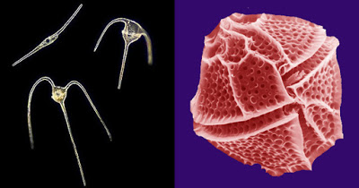
Red dinoflagellates (Example: Gonyaulax) undergo such rapid multiplication that they make the sea appear red (red tides). Toxins released by such large numbers may even kill other marine animals such as fishes.

Slide 12
Euglenoids
Fresh water organisms found in stagnant water.
Instead of a cell wall, they have a protein rich layer called pellicle which makes their body flexible.
They have two flagella, a short and a long one.
Myxotrophic: Though they are photosynthetic in the presence of sunlight, when deprived of sunlight they behave like heterotrophs by predating on other smaller organisms.
Interestingly, the pigments of euglenoids are identical to those present in higher plants.
Example: Euglena

Slide 13
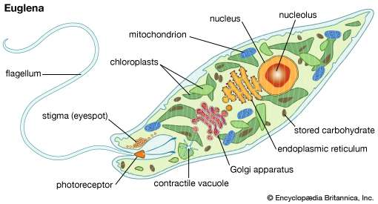

Slide 14
Slime Moulds
Slime moulds are saprophytic protists.
The body moves along decaying twigs and leaves engulfing organic material.
Under suitable conditions, they form an aggregation called plasmodium which may grow and spread over several feet.
During unfavourable conditions, the plasmodium differentiates and forms fruiting bodies bearing spores at their tips.
The spores possess true walls.
They are extremely resistant and survive for many years, even under adverse conditions.
The spores are dispersed by air currents

Slide 15
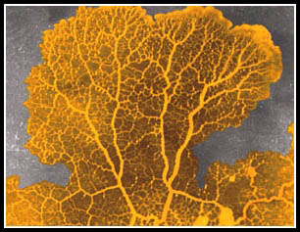
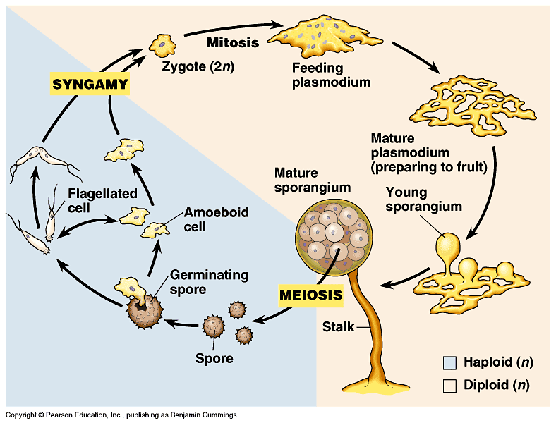

Slide 16
Protozoans
All protozoans are heterotrophs and live as predators or parasites.
They are believed to be primitive relatives of animals.
There are four major groups of protozoans:
  Amoeboid protozoans
  Flagellated protozoans
  Ciliated protozoans
  Sporozoans

Slide 17
1. Amoeboid protozoans
These organisms live in fresh water, sea water or moist soil.
They move and capture their prey by putting out pseudopodia (false feet) as in Amoeba.
Marine forms have silica shells on their surface.
Some of them such as Entamoeba are parasites.
Amoeboid movement.mp4

Slide 18
2. Flagellated protozoans
The members of this group are either free-living or parasitic.
They have flagella.
The parasitic forms cause diseases such as sleeping sickness.
Example: Trypanosoma

Slide 19
3. Ciliated protozoans
These are aquatic, actively moving organisms because of the presence of thousands of cilia.
They have a cavity (gullet) that opens to the outside of the cell surface.
The coordinated movement of rows of cilia causes the water laden with food to be steered into the gullet.
Example: Paramoecium

Slide 20
4. Sporozoans
This includes diverse organisms that have an infectious spore-like stage in their life cycle.
The most notorious is Plasmodium (malarial parasite) which causes malaria, a disease which has a staggering effect on human population.

Slide 21
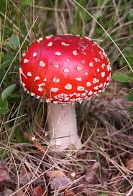
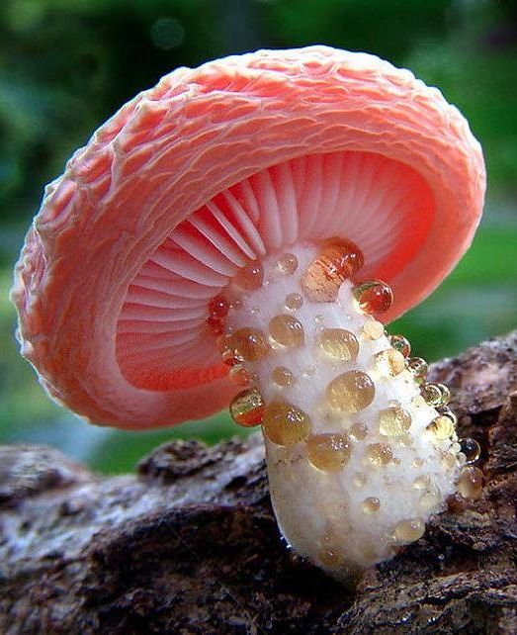
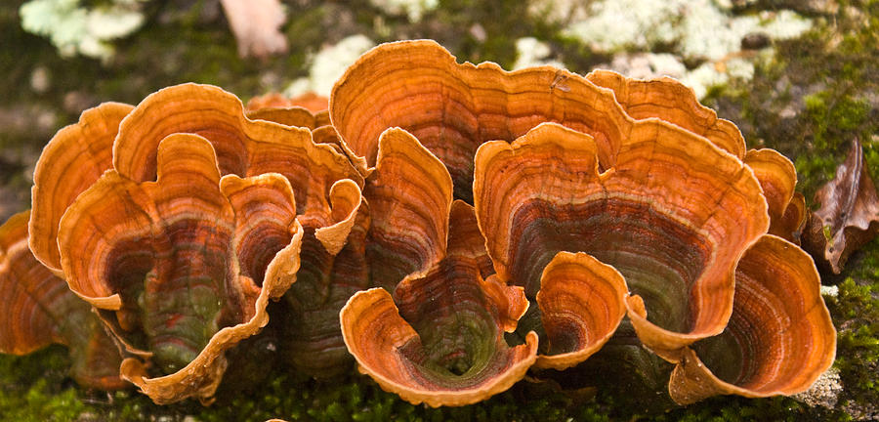
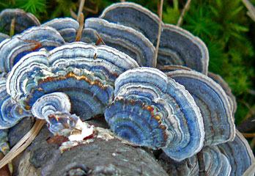
Fungi

Slide 22
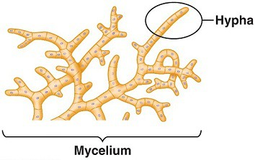
FUNGI
Heterotrophic organisms show a great diversity in morphology and habitat.
Fungi are cosmopolitan and occur in air, water, soil and on animals and plants.
They prefer to grow in warm and humid places.
The cell walls of fungi are composed of chitin.
With the exception of yeasts which are unicellular, fungi are filamentous.
Their bodies consist of long, slender thread-like structures called hyphae. The network of hyphae is known as mycelium.

Slide 23
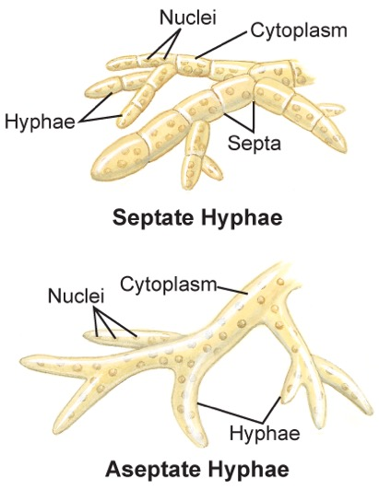
Some hyphae are continuous tubes filled with multinucleated cytoplasm – these are called coenocytic hyphae.
Others have septae or cross walls in their hyphae.

Slide 24
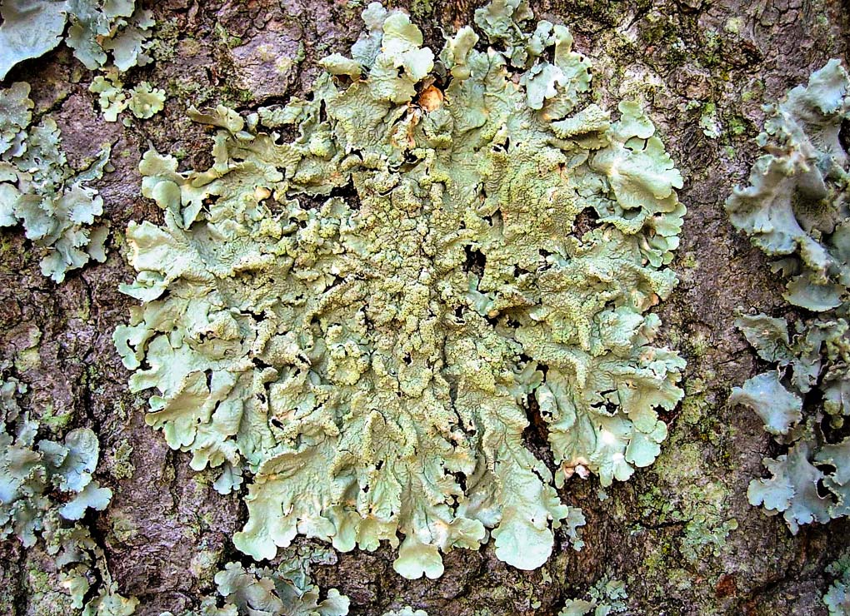
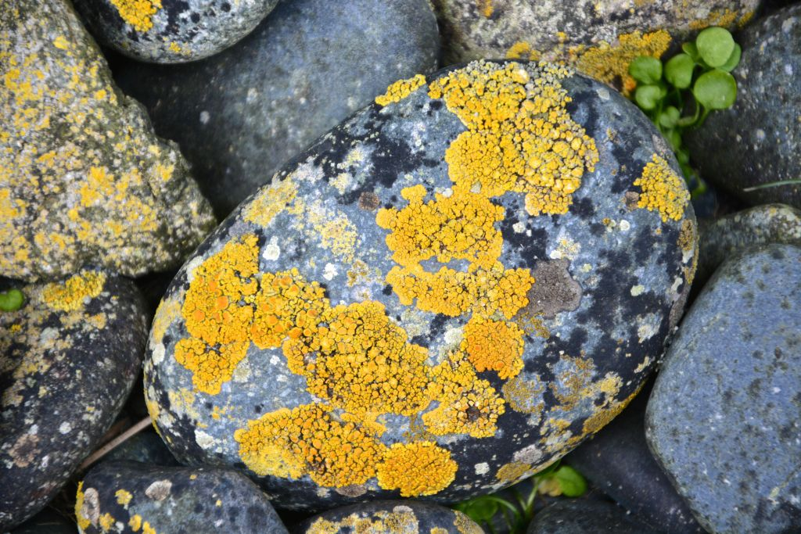
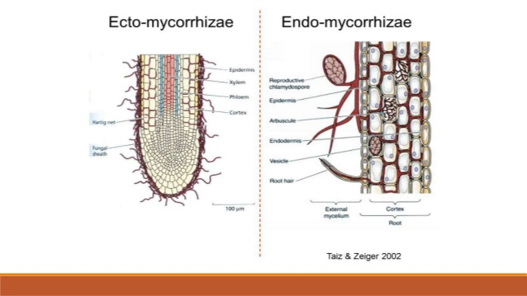
Most fungi are heterotrophic and absorb soluble organic matter from dead substrates and hence are called saprophytes.
Those that depend on living plants and animals are called parasites.
They can also live as symbionts – in association with algae as lichens and with roots of higher plants as mycorrhiza.
LICHENS

Slide 25
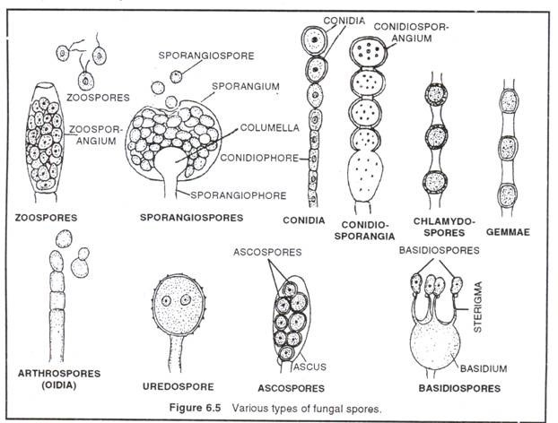
Reproduction in fungi can take place by vegetative means –
    Fragmentation,
    Fission and
    Budding.
Asexual reproduction is by spores called
    Conidia or
    Sporangiospores or
    Zoospores,
Sexual reproduction is by
  Oospores,
  Ascospores and
  Basidiospores.
The various spores are produced in distinct structures called fruiting bodies.

Slide 26
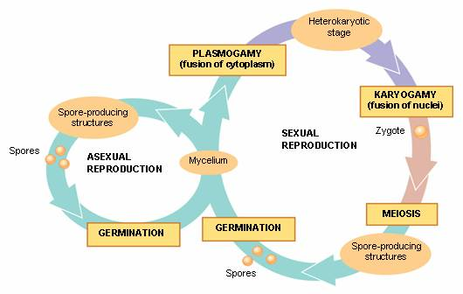
The sexual cycle involves the following three steps:
  Fusion of protoplasms between two motile or non-motile gametes called plasmogamy.
  Fusion of two nuclei called karyogamy.
  Meiosis in zygote resulting in haploid spore

Slide 27
In some fungi the fusion of two haploid cells immediately results in diploid cells (2n).
However, in other fungi (ascomycetes and basidiomycetes), an intervening dikaryotic stage (n + n, i.e., two nuclei per cell) occurs;
Such a condition is called a dikaryon and the phase is called dikaryophase of fungus.
Later, the parental nuclei fuse and the cells become diploid.
The fungi form fruiting bodies in which reduction division occurs, leading to formation of haploid spores.

Slide 28
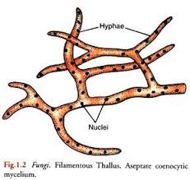
Phycomycetes
Members are found in aquatic habitats and on decaying wood in moist and damp places or as obligate parasites on plants.
The mycelium is aseptate and coenocytic.
Asexual reproduction takes place by
    zoospores (motile) or
    By aplanospores (non-motile).
Spores are endogenously produced in sporangium.

Slide 29
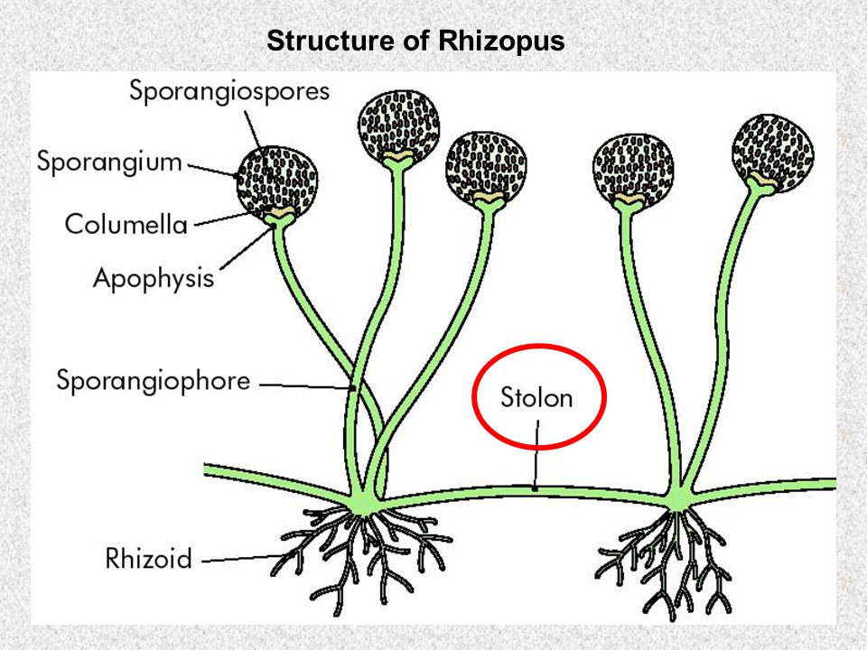
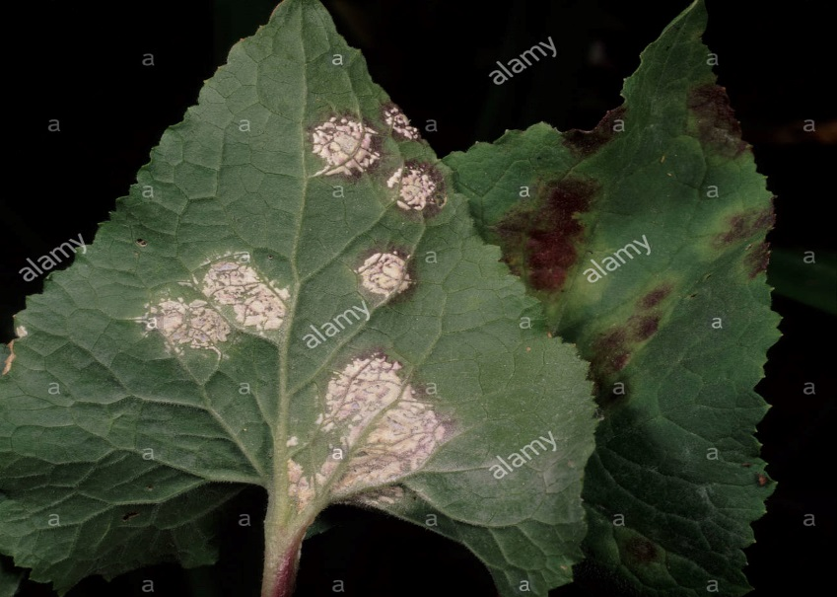
A zygospore is formed by fusion of two gametes.
These gametes are
    similar in morphology (isogamous) or
    dissimilar (anisogamous or oogamous).
Some common examples are
    Mucor
    Rhizopus (the bread mould) and
    Albugo (the parasitic fungi on mustard).
Albugo

Slide 30
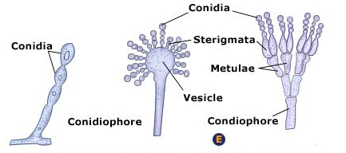
Ascomycetes
Commonly known as sac-fungi, the ascomycetes are mostly multicellular, e.g., Penicillium, or rarely unicellular, e.g., yeast (Saccharomyces).
They are saprophytic, decomposers, parasitic or coprophilous (growing on dung).
Mycelium is branched and septate.
The asexual spores are conidia produced exogenously on the special mycelium called conidiophores.
Conidia on germination produce mycelium.

Slide 31
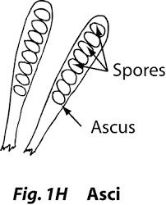
Sexual spores are called ascospores which are produced endogenously in sac like asci (singular ascus).
These asci are arranged in different types of fruiting bodies called ascocarps.
Some examples are
    Aspergillus (Figure 2.5b),
    Claviceps and
    Neurospora.
Neurospora is used extensively in biochemical and genetic work.
Many members like morels and truffles are edible and are considered delicacies.

Slide 32
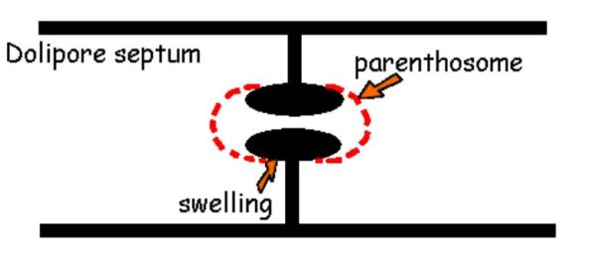
Basidiomycetes
Commonly known forms of basidiomycetes are mushrooms, bracket fungi or puffballs.
They grow in soil, on logs and tree stumps and in living plant bodies as parasites, e.g., rusts and smuts.
The mycelium is branched and septate ( Dolipore Septum)
MUSHROOM
Bracket Fungi

Slide 33
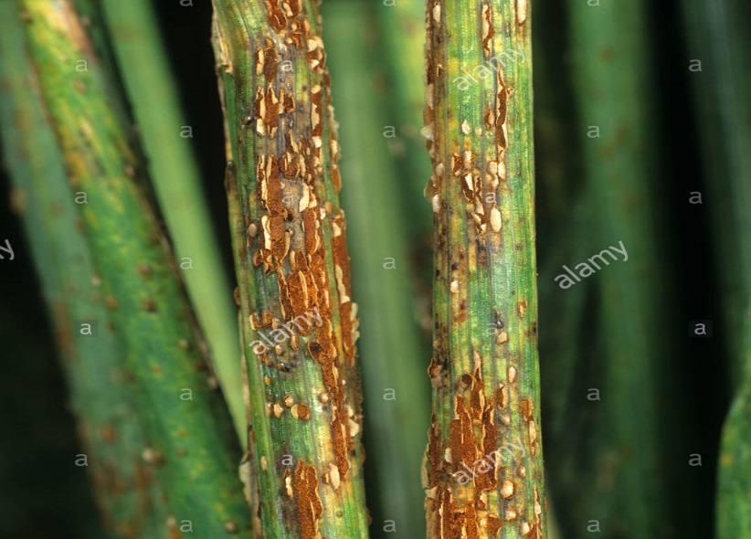
The asexual spores are generally not found, but vegetative reproduction by fragmentation is common.
The sex organs are absent, but plasmogamy is brought about by fusion of two vegetative or somatic cells of different strains or genotypes.
The resultant structure is dikaryotic which ultimately gives rise to basidium. Karyogamy and meiosis take place in the basidium producing four basidiospores.
The basidiospores are exogenously produced on the basidium (pl.: basidia).
The basidia are arranged in fruiting bodies called basidiocarps.
Some common members are
    Agaricus (mushroom)
    Ustilago (smut) and
    Puccinia (rust fungus).
Puccinia (rust fungus)

Slide 34
Deuteromycetes
Commonly known as imperfect fungi because only the asexual or vegetative phases of these fungi are known.
When the sexual forms of these fungi were discovered they were moved into classes they rightly belong to.
It is also possible that the asexual and vegetative stage have been given one name (and placed under deuteromycetes) and the sexual stage another (and placed under another class).
Later when the linkages were established, the fungi were correctly identified and moved out of deuteromycetes.

Slide 35
The mycelium is septate and branched.
Some members are saprophytes or parasites while a large number of them are decomposers of litter and help in mineral cycling.
Some examples are
    Alternaria,
    Colletotrichum and
    Trichoderma.

